Slide 1
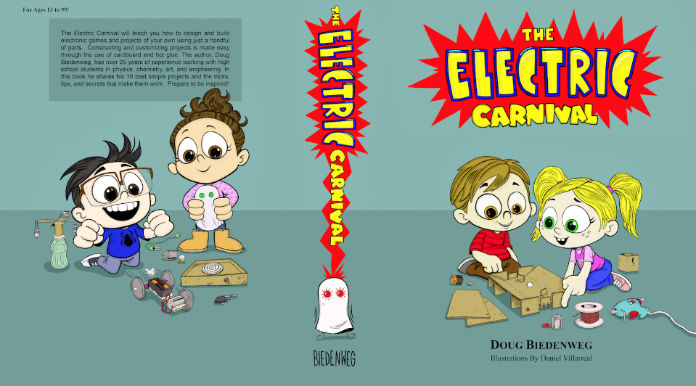

Slide 29
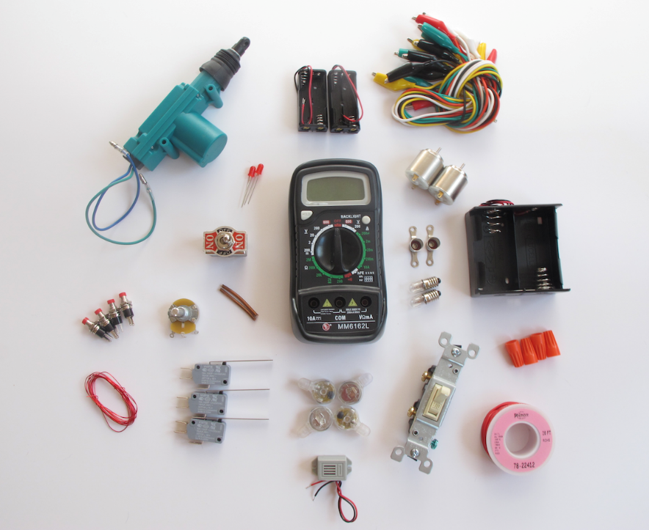

Slide 30
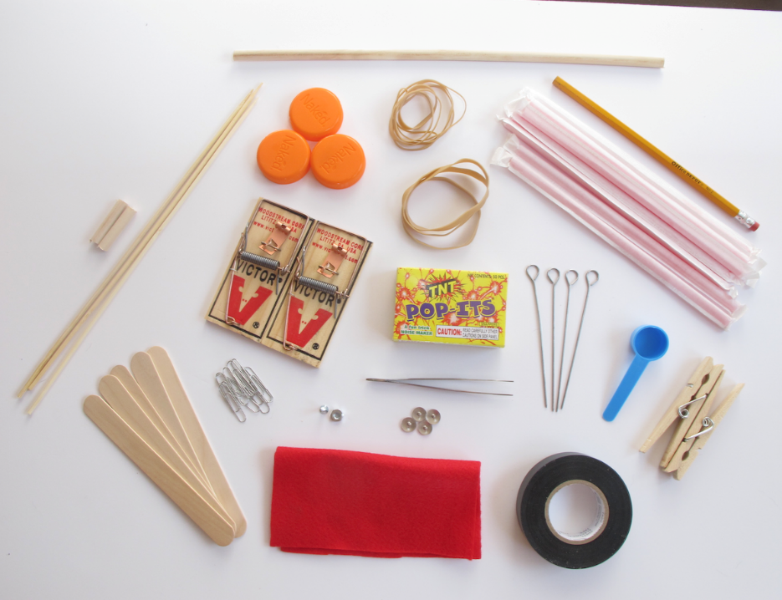

Slide 31
Why this book and kit are a value:
Suppose you pay $30,000 a year for an education.
You receive about 172 school days for this money and about 5 hours of academics a day
That is 860 hours of education for $30,000

Slide 32
So you are paying $30,000/860 hours
This is $34.88 per hour of class room time
Essentially the Exact Price of My Book!!!

Slide 33
So if you believe this little exercise in financial analysis….
You get all the love, sweat, tears, knowledge, and imagination that Danny and I poured into this book for just the measly price of one hour of class time with a teacher!!!!

Slide 34
Not only this, but the book and the kit combined cost less than the price of a single academic day at school!!!!
One academic day costs--$175.00
The book and kit together cost--$155.00

Slide 35
Imagine all you will learn by
i) training yourself in the fundamentals of electricity.
ii) training yourself to analyze and solve circuit problems with a meter.
iii) constructing and trouble shooting 10 cool games and toys that challenge you scientifically, creatively, and artistically!!

